Slide 1

Student portal Microservice application
Presented by:
Riad Mostafa ID: 2022/07822
Abdelrahman Ahmed ID: 2022/01681
Abdelrahman Walid ID: 2022/05134

Slide 2
Theory: How Microservices work
Decomposition of features
Independent Deployment
Communication via API
Decentralized Data Management

Slide 3
Theory: how Microservices work
Decomposition of features: instead of having one large application, the software is broken down into multiple specific services.
For example: an e-commerce website has separate microservices for Inventory, shopping cart, orders.

Slide 4
Theory: how Microservices work
Independent Deployment
Since every service is made separate, a developer can update one service without having to redeploy the other services

Slide 5
Theory: how Microservices work
Communication Via APIs
To have the separate systems “communicate” with each other, they need to use the Application Programming Interfaces (API), through HTTP/REST.

Slide 6
Theory: how Microservices work
Decentralized Data Management
Each individual service has its own database dedicated for it
For example: the authentication has its own database, the courses has its own database, the notification has its own database.

Slide 7
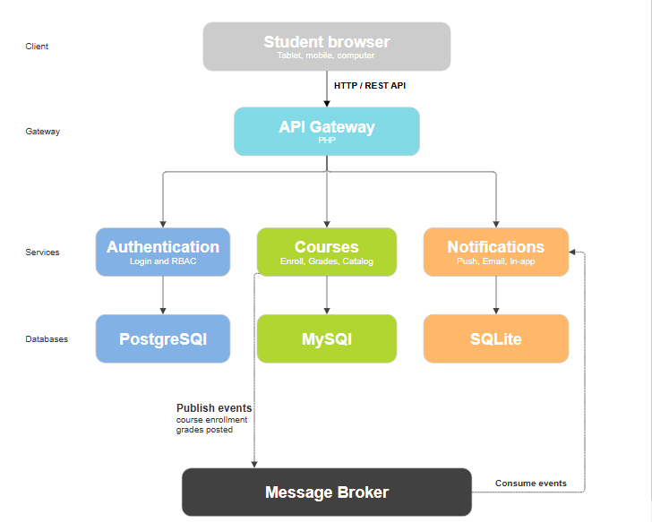
Architecture diagram

Slide 8
Why Its Useful
Targeted scalability
Fault isolation
Technology Agnostic
Faster Development (Agile)

Slide 9
Why Its Useful
Targeted Scalability
Microservices allow for scalability of resources of a specific services that require it, saving a lot of money and computing power

Slide 10
Why Its Useful
Fault isolation
If a bug affects one server then the rest of the application stays online, without microservice architecture, the whole website will crash if the same issue occurs.

Slide 11
Why Its Useful
Technology Agnostic
The whole app doesn’t need to be written in the same programming language, one microservice can be written in python while the other can be written in java

Slide 12
Why Its Useful
Faster Development (Agile)
Large teams can be split into different small groups with each one focusing on a specific microservice.
Development and testing in one server can function normally without affecting the other

Slide 13

Thank you

